Slide 1
SFPD Crime Incidents
Data Analysis of Crimes across Various Police Districts in San Francisco
Shyamala Gurumurthy
Springboard Foundations of Data Science: Capstone

Slide 2
San Francisco Police Crime Incidents
The city of San Francisco has one of the highest crime rates in the country
By using crime data released by SFPD is it possible to,
Identify areas with high density of crimes
Inform the community of days and times to be vigilant
Determine if an incident would be resolved by a Police department, given its category
Infer if crime rates affect property prices in San Francisco

Slide 3
Analysis of SFPD Crime Data
01
Data Wrangling

02
Exploratory Data Analysis

03
Statistical Analysis

04
Machine Learning


Slide 4
The Data
Incidents
Police Department incidents for years 2003 – 2017 derived from the SFPD Crime Incident Reporting System
House prices
Real estate prices for all regions in US for years 1996 – 2017 downloaded from Zillow
~2.18 million observations
13 features
~15000 records
268 columns including price per sqft for all 12 months.

Slide 5
Data Wrangling: Final Dataset
Incidents
Columns with unique Ids removed
Date column separated into Year/Month/Day
Columns renamed to more descriptive names
Missing observation filled with appropriate information
House prices
Filtered house prices in San Francisco
Data converted from wide format to long format
Year and month separated into 2 columns
Columns renamed to more descriptive names
Final Dataset
Incidents dataset + zipcode column added using zipcode library
House prices joined to Final dataset using zipcode as key
Combined common crime types to reduce number of categories from 39 to 15

Slide 6
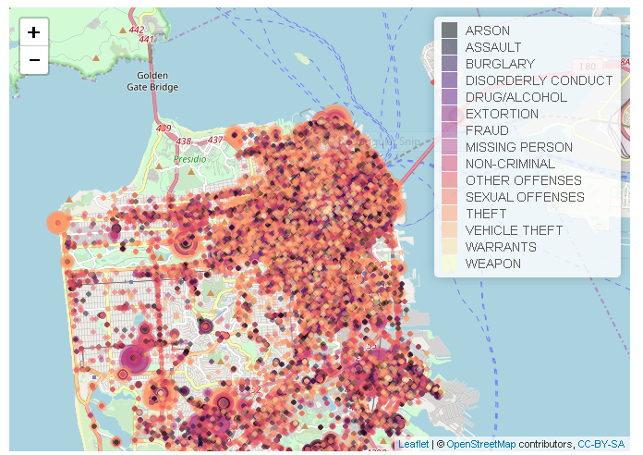
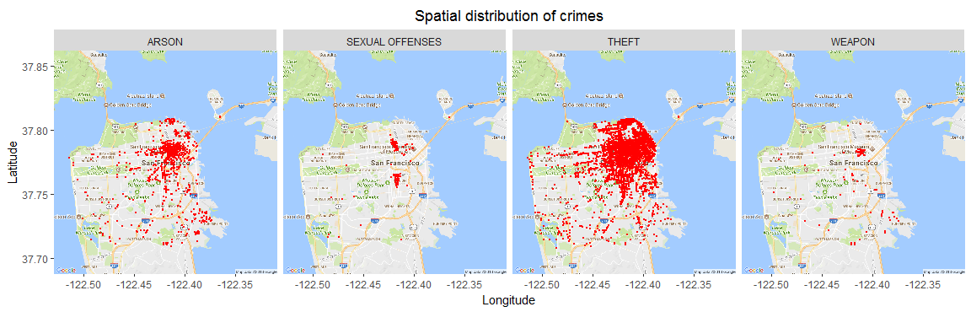
Spatial Distribution of Crimes by Category
Higher density of crimes in the north-east → SOUTHERN, MISSION, CENTRAL, BAYVIEW and NORTHERN police districts
Epicenter for most crimes categories the same → theft is most predominant!

Slide 7
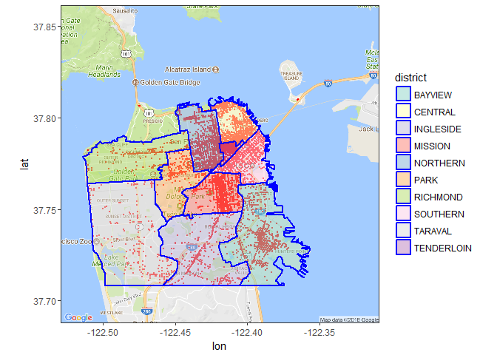
Spatial Distribution of Crimes by Police District
BAYVIEW, CENTRAL, MISSION, NORTHERN and SOUTHERN have a higher density of crime compared to other regions

Slide 8
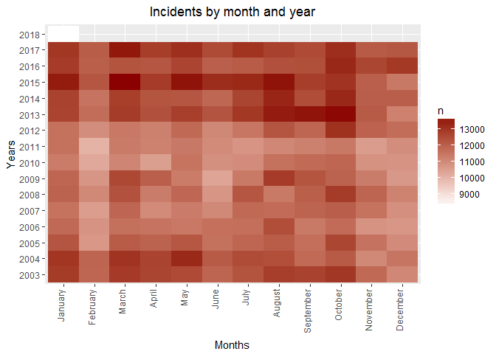
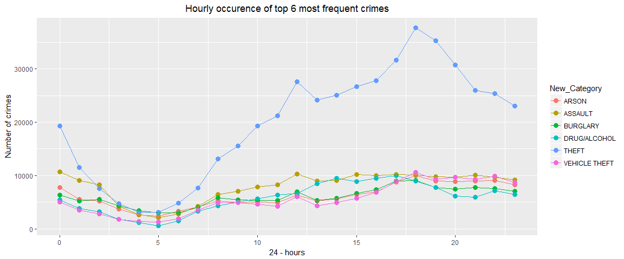
Incidents by Year, Month and Time
3 a.m - 7 a.m: Lower number of crimes → most likely because a majority of the people are at home during this time.
10 a.m - 1 p.m: Has a peak at 12 p.m → lunch break
5 p.m - 12 a.m: Higher crimes → increase in population due to people returning from work.
Increase in crimes from 2013 - 2017 compared to the previous years
Crimes lower during February, November and December
Summer months of March to October see a relatively larger number of crimes

Slide 9
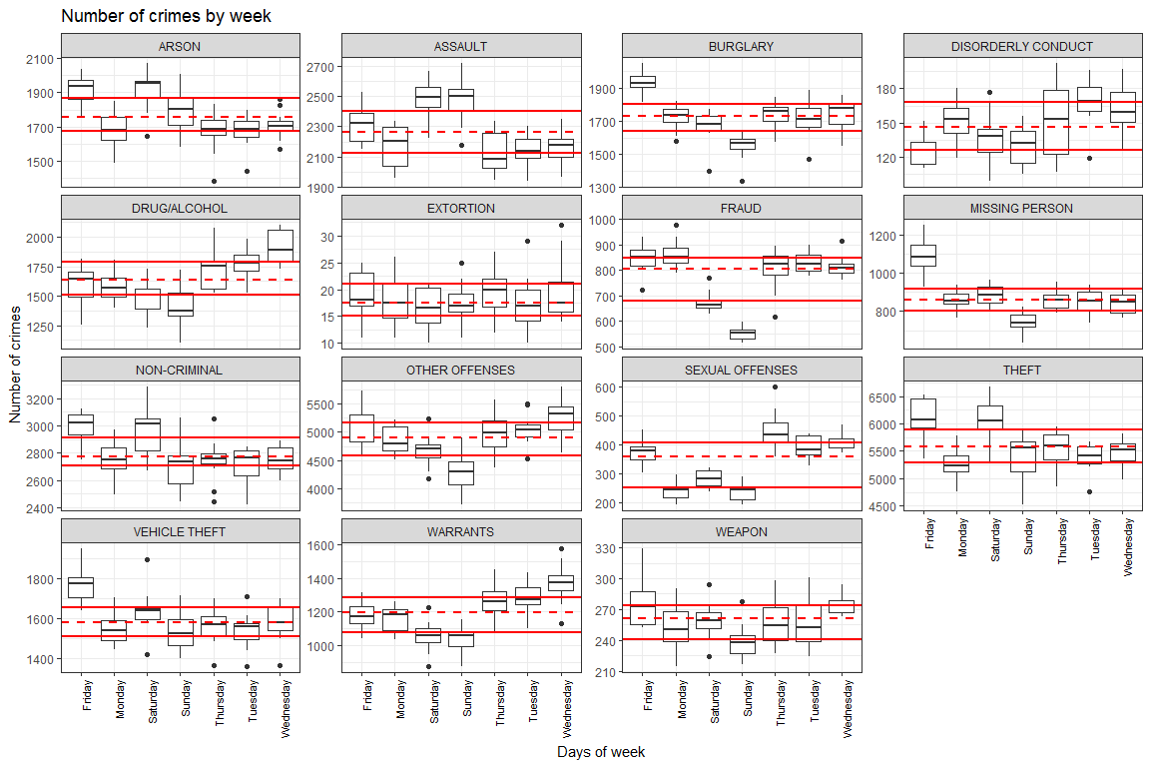
Crimes by Day of the Week
Days of the week for which the number of crimes are above or below the distribution (solid lines) vary according to the crime type
Socio-economic reason depends on crime type
E.g. for the spike in Wednesday for DRUG/ALCOHOL → Wednesday is Social Security payday so addicts get paid and relapse! [1]

Slide 10
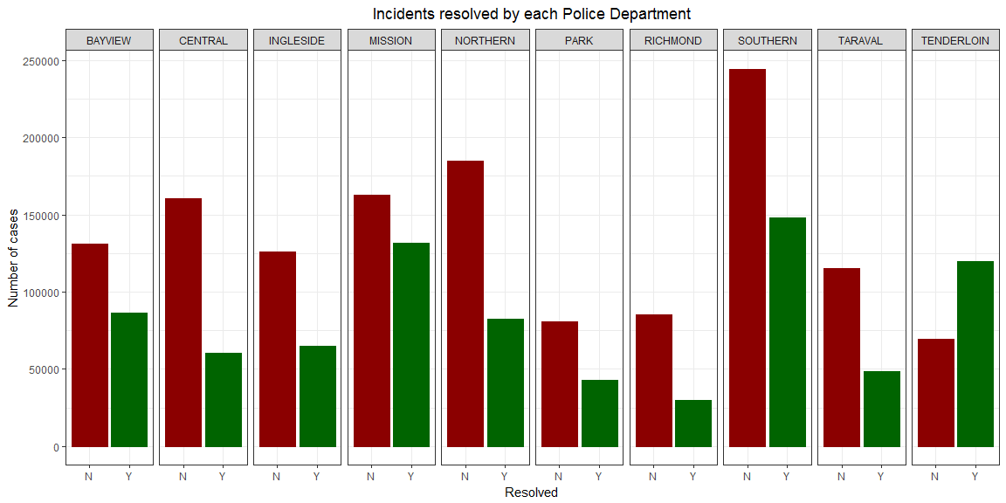
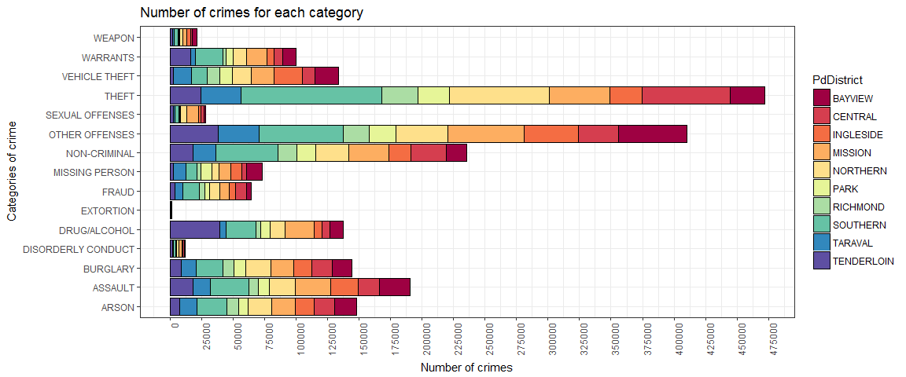
Incidents and their Resolution by Police District
THEFT is largest crime category: ~475000 incidents
OTHER_OFFENSES: ~410000 incidents
Individual contributions from the remaining categories are ~240000 each, less than 50% compared to THEFT
Largest contributors → SOUTHERN, NORTHERN, CENTRAL, MISSION, and BAYVIEW police districts.
SOUTHERN, MISSION, CENTRAL and NORTHERN regions have the largest number of crimes, but the SFPD has not been able to resolve most of the cases.
Tenderloin is the only police district where the number of resolved cases exceed the number of unresolved cases.

Slide 11
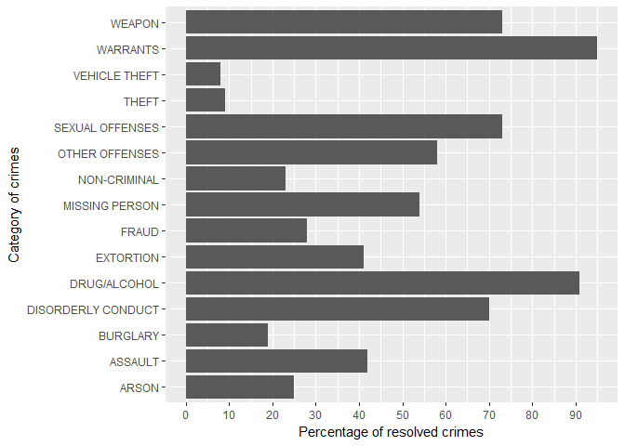
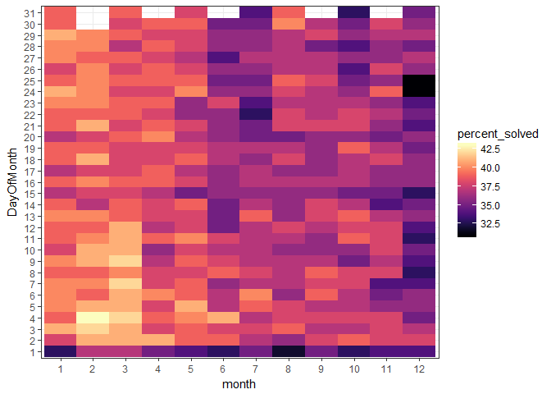
Incidents and their Resolution by Category and Month
Warrants and Drug/Alcohol categories have the highest percentage of resolved crimes .
Theft have the lowest percentage of crimes resolved despite it having the largest number of crimes
More crimes resolved during January-May.
Percentage of crimes resolved start decreasing in June and is lowest in December.
Most crimes that occur on 1st of any month have the least percentage of resolved cases.

Slide 12
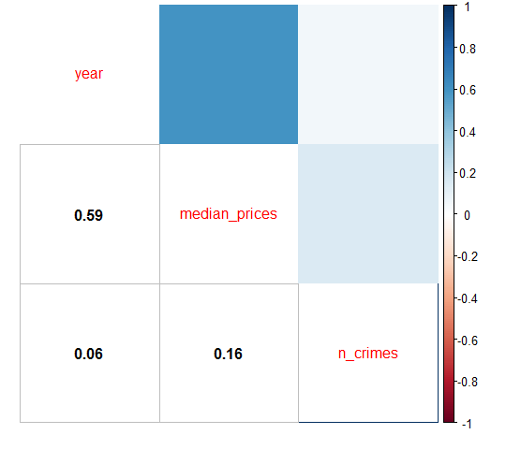
Relationship between House Price and Crimes
High correlation between price per sqft and year
Low correlation between price per sqft and number of incidents in an area
Number of crimes in an area does not effect real estate property price!

Slide 13
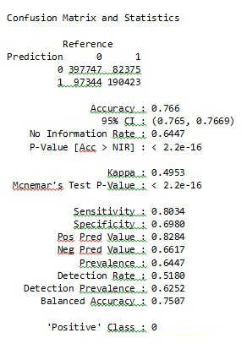
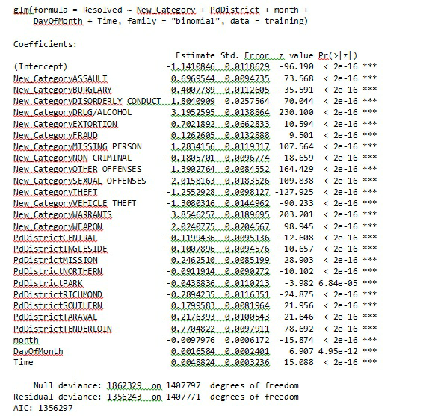
Machine Learning
Data partitioned into 70% training and 30% testing
Logistic regression with Resolved as response and Category, Police District, Month, Day Of Month and Time as predictors
Model performance →
sensitivity = 0.80
specificity = 0.69
accuracy = 0.766.
Theft and Vehicle Theft have the least chance of being resolved by the police
Tenderloin has highest probability of crime resolution

Slide 14
Recommendation
To the SFPD
Other police districts would perhaps benefit by adopting specific strategies successfully employed by Tenderloin which could help reduce incidents that are difficult to resolve.
To the city administration
Taking extra security measures and deploying more police forces during the summer months of March to October could reduce incidents.
To the resident population
General population can deter crimes by being vigilant and cautious especially in areas covered by the Bayview, Central, Mission, Northern and Southern police districts.

